Slide 1
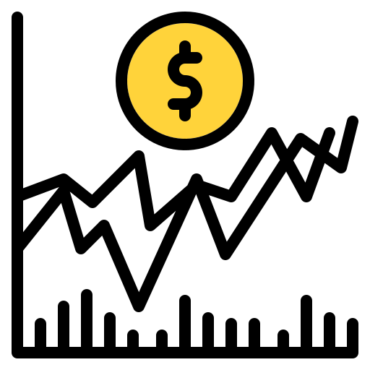
Financial Analysis Report

Slide 2

Agenda
Introduction
Sample Data
Main KPIs
Dashboard
Key Findings

Slide 3
Financial Analysis
The financial markets of the world are deeply influenced by the performance of the top 500 companies, as listed in indices like the S&P 500.
Monthly fluctuations in these companies' stock prices reflect broader economic trends, investor sentiment, and geopolitical events.
Monthly movements in their stock prices are closely watched indicators of economic health and investor confidence.
These companies span diverse sectors like technology, finance, and healthcare, collectively shaping trends in mergers, acquisitions, and capital markets activities worldwide.

Slide 4
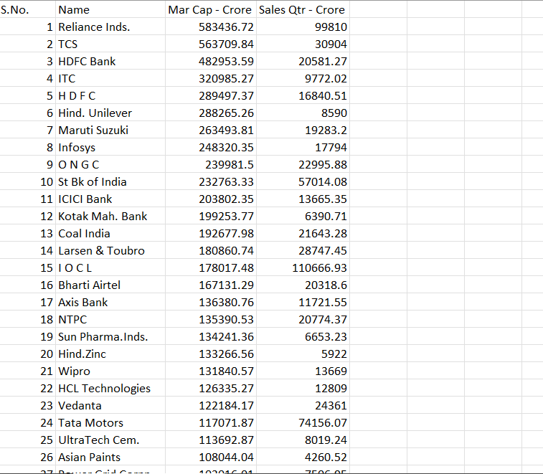
DATA

Slide 5
Main KPIs
Total Industries
Total Market Cap
Total QTR Sales

Slide 6
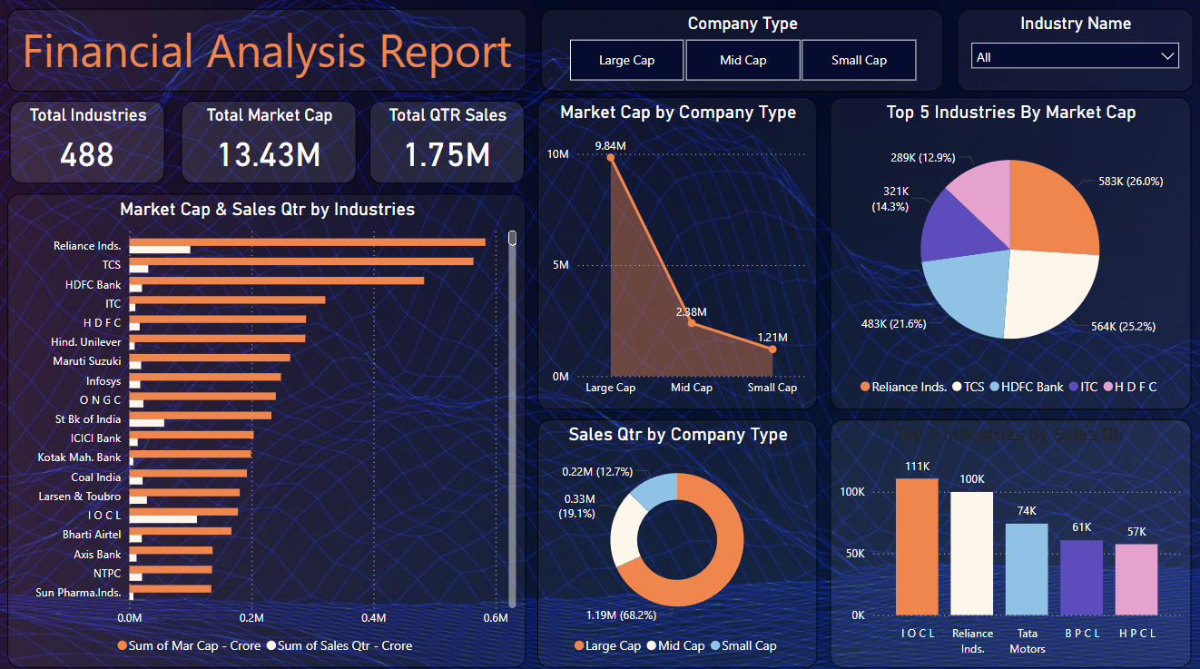
DASHBOARD

Slide 7
Key Findings
𝗟𝗲𝗮𝗱𝗶𝗻𝗴 𝗜𝗻𝗱𝘂𝘀𝘁𝗿𝗶𝗲𝘀 𝗯𝘆 𝗠𝗮𝗿𝗸𝗲𝘁 𝗖𝗮𝗽:
𝖱𝖾𝗅𝗂𝖺𝗇𝖼𝖾 𝖨𝗇𝖽𝗎𝗌𝗍𝗋𝗂𝖾𝗌: ₹𝟧𝟪𝟥.𝟦𝟦𝖪
𝖳𝖢𝖲: ₹𝟧𝟨𝟥.𝟩𝟣𝖪
𝖧𝖣𝖥𝖢 𝖡𝖺𝗇𝗄: ₹𝟦𝟪𝟤.𝟫𝟧𝖪
𝗠𝗮𝗿𝗸𝗲𝘁 𝗖𝗮𝗽 𝗗𝗶𝘀𝘁𝗿𝗶𝗯𝘂𝘁𝗶𝗼𝗻:
𝖫𝖺𝗋𝗀𝖾 𝖢𝖺𝗉: ₹𝟣𝟢.𝟩𝖬
𝖬𝖾𝖽𝗂𝗎𝗆 𝖢𝖺𝗉: ₹𝟤.𝟤𝖬
𝖲𝗆𝖺𝗅𝗅 𝖢𝖺𝗉: ₹𝟢.𝟧𝖬
𝗧𝗼𝗽 𝗜𝗻𝗱𝘂𝘀𝘁𝗿𝗶𝗲𝘀 𝗯𝘆 𝗤𝘂𝗮𝗿𝘁𝗲𝗿𝗹𝘆 𝗦𝗮𝗹𝗲𝘀:
𝖨𝖮𝖢𝖫: ₹𝟣𝟣𝟣𝖪
𝖱𝖾𝗅𝗂𝖺𝗇𝖼𝖾 𝖨𝗇𝖽𝗎𝗌𝗍𝗋𝗂𝖾𝗌: ₹𝟣𝟢𝟢𝖪
𝖳𝖺𝗍𝖺 𝖬𝗈𝗍𝗈𝗋𝗌: ₹𝟩𝟦𝖪

Slide 8
Thank you
Vedant Burande
vedd.exe@gmail.com

